Slide 1
The history of the invention of the first modern computer
Kraev Stepan, Serebryakov Grigoriy ИУ9-21Б

Slide 2
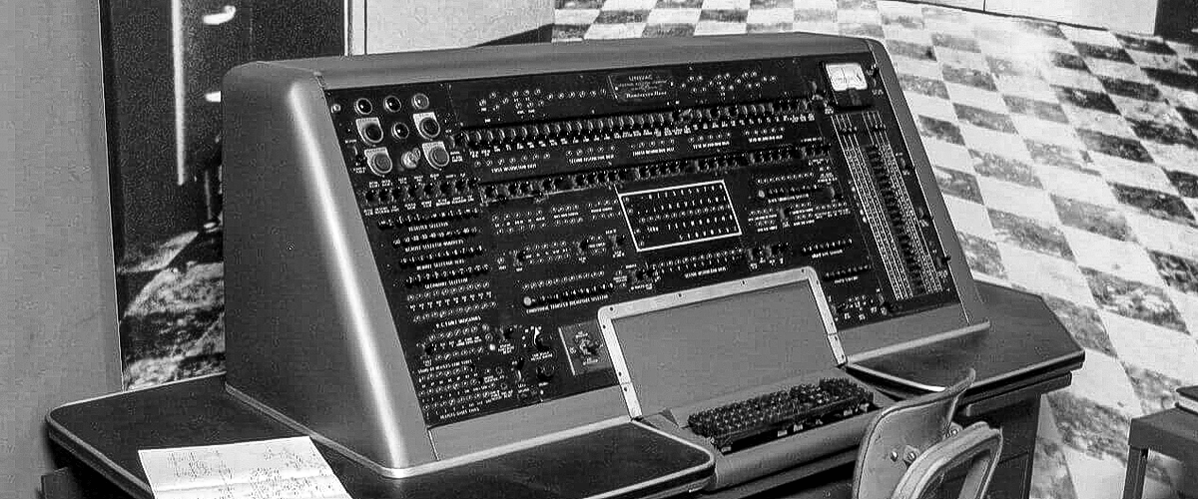
We use computers every day. But have you ever stopped to think about who invented computers and how they came to dominate our lives?

Slide 3
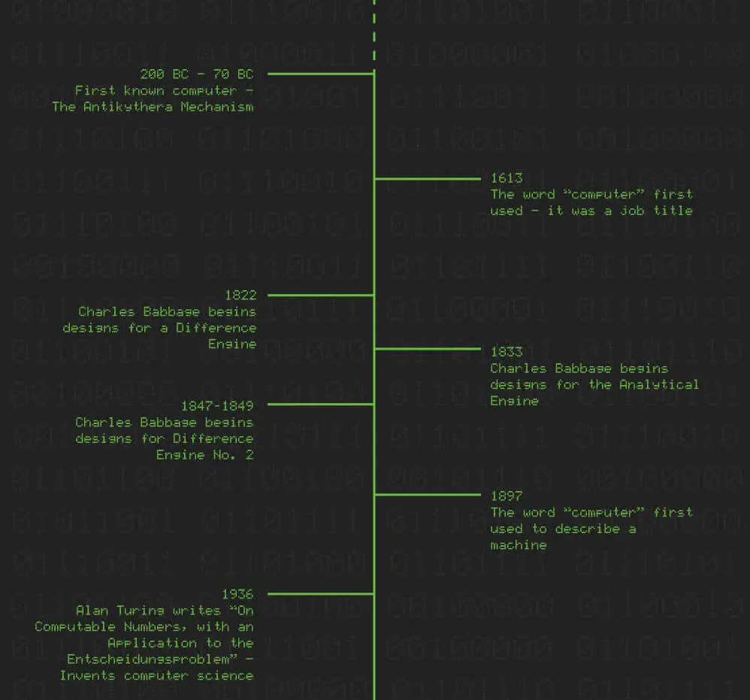
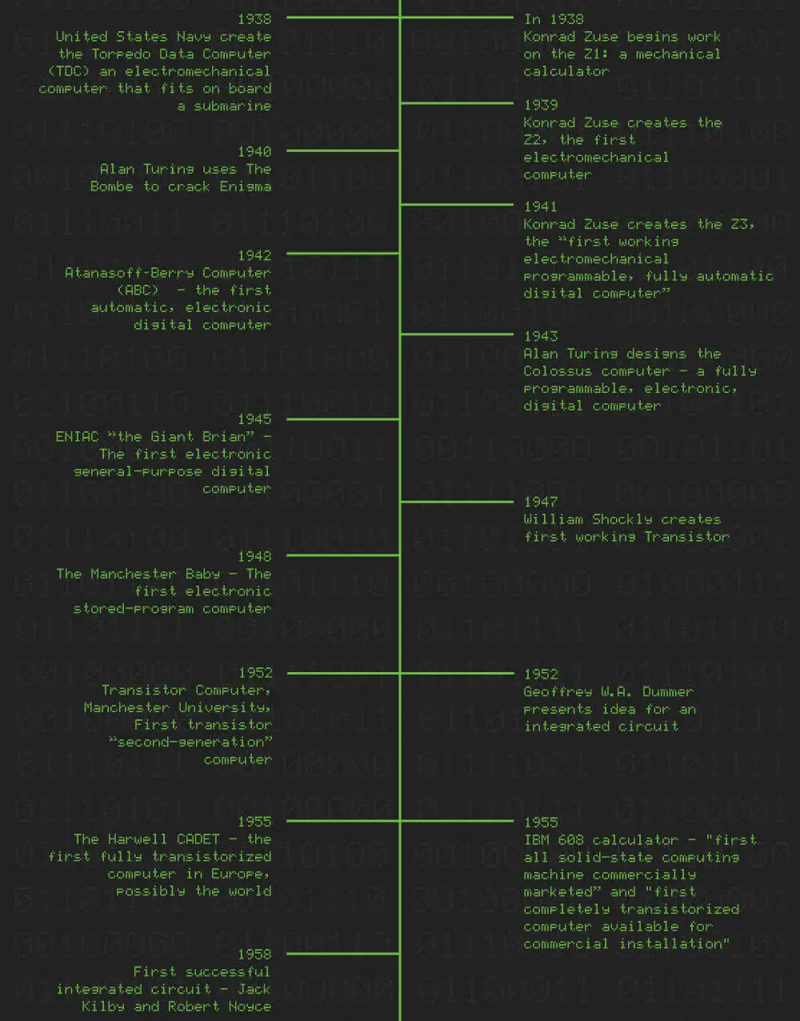
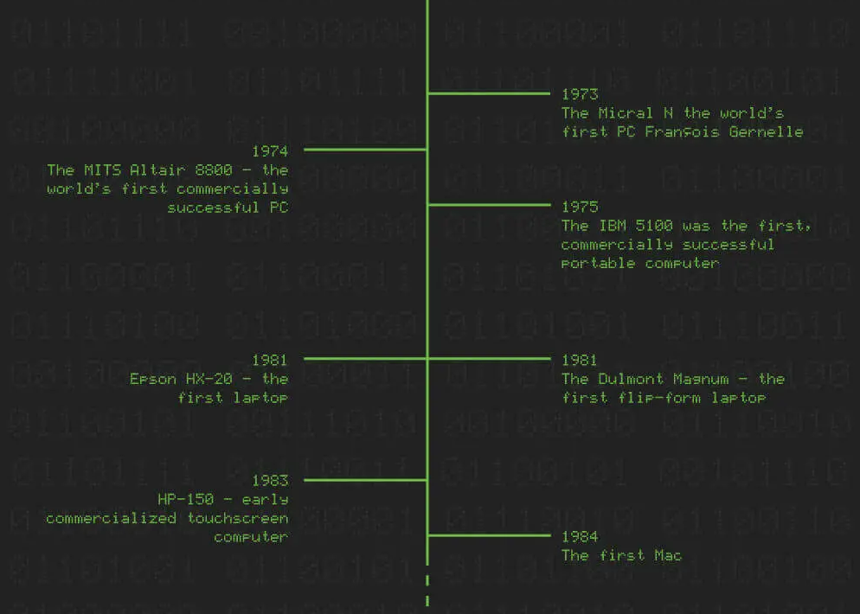
This is a detailed history of the invention of the computer

Slide 4
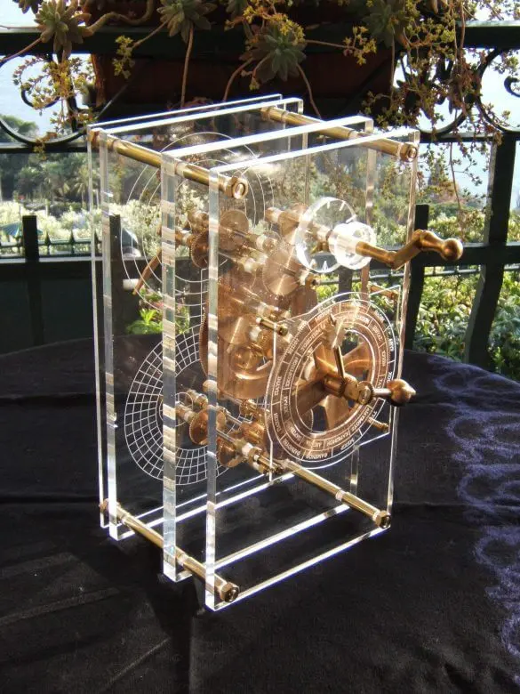
The first computer
Early computers were actually people, not machines -- it was a job title. The word dates back to 1613. "Computers" performed complex calculations; they were mathematicians and bookkeepers.
The first-word "computer" was used to describe a machine was 1897.
The first computer, that we know about, is the Antikythera mechanism (200 BC -- 70 BC). It is an ancient hand-powered mechanical device. Archeologists believe it was used to calculate eclipses and other astronomical events.

Slide 5
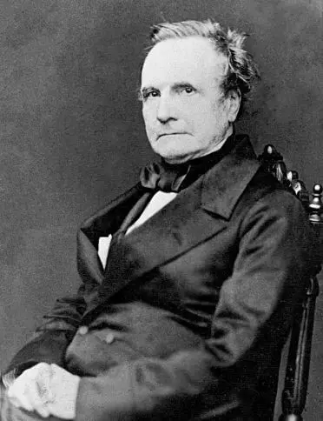
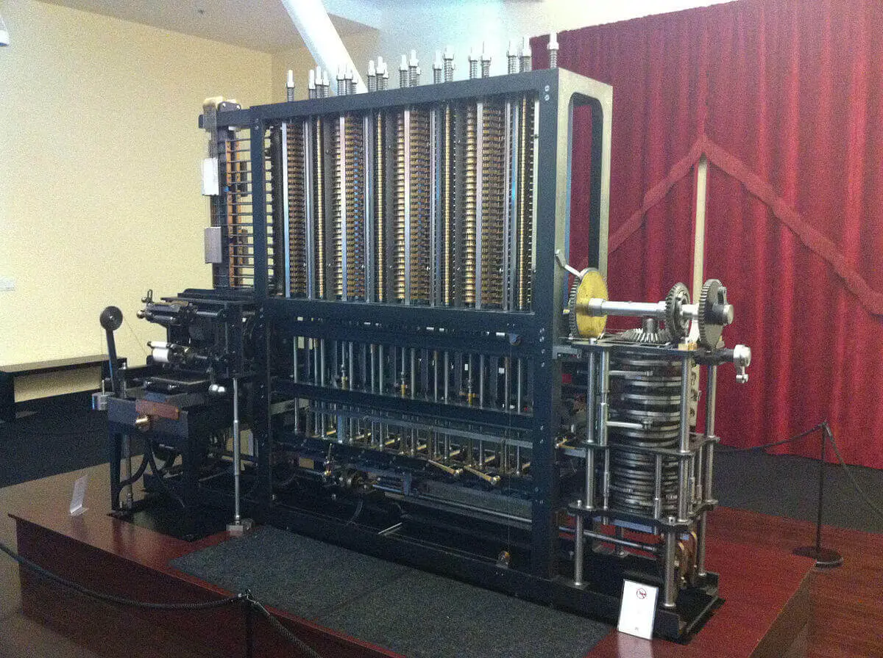
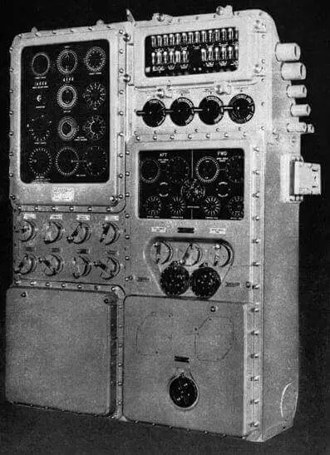
Who invented the first electromechanical computer?
In 1938 the United States Navy invented the Torpedo Data Computer (TDC), possibly the world's first electromechanical computer. It was designed to track a target, and aim & fire a torpedo from a submarine. At the time, the Japanese also had an automated, torpedo firing computer on their submarines. However, it was not capable of tracking a target.
Charles Babbage, an English polymath, is often thought of as "the man who invented computers.” From 1822 until his death in 1871, he designed three computers, but never actually constructed any of them
Between 1847--1849 Babbage created drawings for the Difference Engine No. 2, a second "computer". Finally, In 1991, the British Science museum constructed the design from Babbage's original plans.

Slide 6
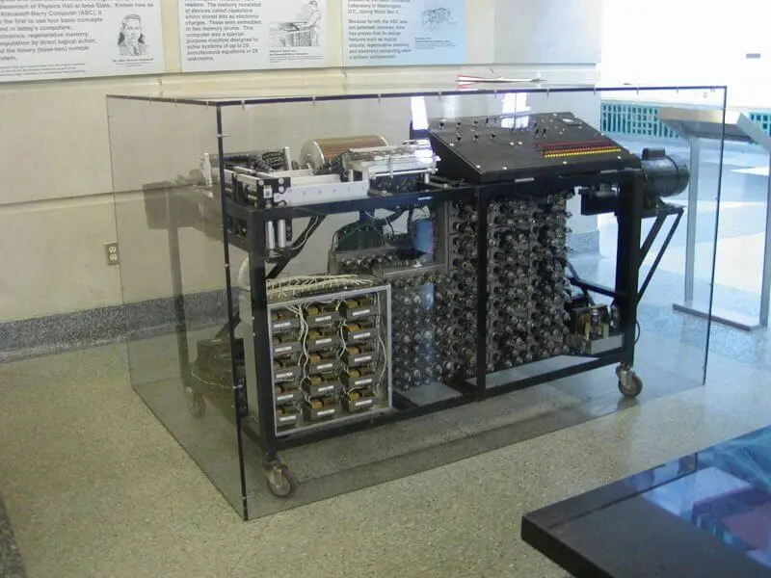
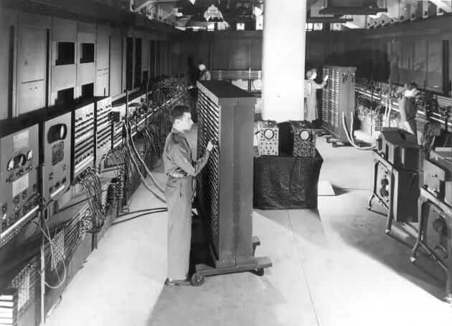
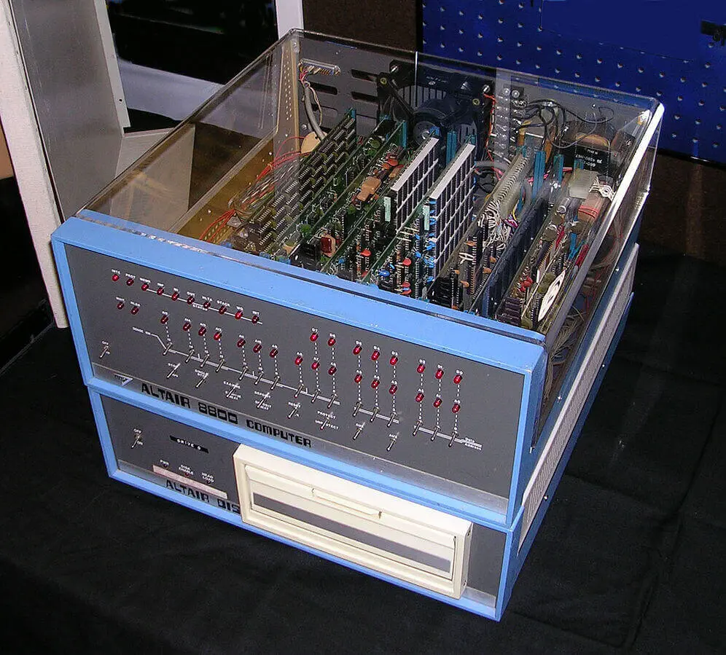
When was the first electronic, digital computer invented?
The Atanasoff--Berry Computer "ABC" (1942) was the first automatic, electronic digital computer. However, it is not widely considered to be a "computer.” It lacked many of the functionalities of modern computers; it was designed for one specialist task.
The first electronic general-purpose digital computer
The ENIAC (Electronic Numerical Integrator and Computer) aka "the Giant Brian" (1945) was the first electronic general-purpose digital computer. It was fully reprogrammable and so, able to solve a complex number of problems. It could take several days to program because it was programmed via external switches and dials.
The ENIAC took 20 seconds to complete its first calculation; a mechanical computer would have taken 40 hours.
Who invented the PC?
François Gernelle invented the Micral N, the world's first "personal computer"(1973). It was, no, a commercial success.
The Micral N had a speed of 500 KHz, was capable of running approximately 50,000 instructions per second,d and cost 8,500 French Francs (around €7,750 in 2020).
The MITS Altair 8800 (1974) was the first PC with any commercial success. The computer was so successful that the company hired extra staff to keep up with the demand!
These were the first steps towards the creation of desktop computers

Slide 7
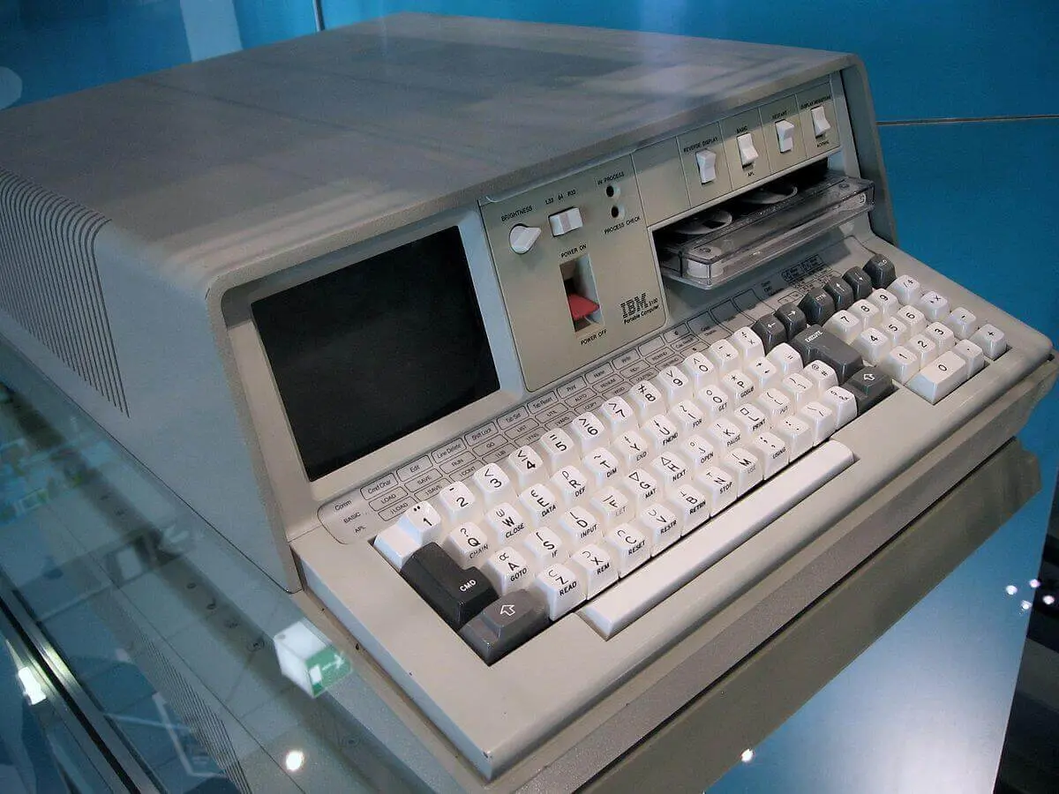
The first portable computer
The IBM 5100 (1975) was the first, commercially successful, portable computer. Although it came with a handy travel case, earning it the "portable" title, it weighed 23 kg 50 lbs)
The IBM 5100 had a 16-bit processor, took a quarter-inch cartridge (QIC) magnetic tape drive, and allowed users to switch the screen between white on black and black on white.
This device led to the creation of modern laptops

Slide 8

Thank you for watching

